Slide 1

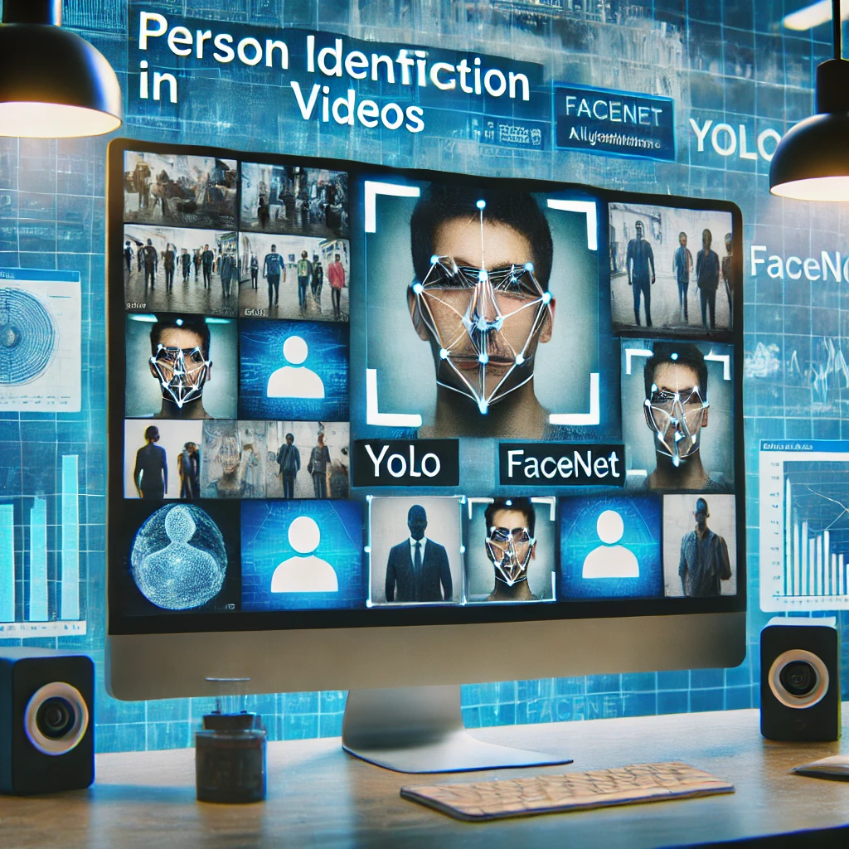


AI-Driven Person Recognition and Identification in Videos
Capstone Project Phase B
Rom Harel
Itai Benjamin
Supervizor: Mr. Ilya Zeldner Project code: 24-1-D-35
01

Slide 2


Overview
Introduction
03
Proposed Solution
04
System Workflow
05
Yolo
06-09
FaceNet
10-11
Architecture & Diagrams
12-15
Expected Challenges
15
User Interface
16
Improvements
17-20
Testing
21
02

Slide 3
Introduction
High demand for accurate person identification in videos.
Increased Need Post-October 7
No free, user-friendly video analysis system available.
Introduction
Proposed Solution
System Workflow
YOLO
FaceNet
Architecture
&
Diagrams
Expected Challenges
User Interface
Improvements
Testing
03
Notes:
אם זה הצגת הבעיה, צריך לשכנע יותר. מדוע מה שיש כרגע לא מספיק? מה יש כרגע? הבעיה של חיפוש דמויות ספציפית בוידאו אנחנו מכירים את זה שעושים את זה במכה אחת , אנחנו רוצים לחדד את הזיהוי

Slide 4




Proposed Solution
Object Detection
Using YOLO Model
Facial Recognition
Using FaceNet Model
Integrate YOLO and FaceNet
User-Friendly Interface
Introduction
Proposed Solution
System Workflow
YOLO
FaceNet
Architecture
&
Diagrams
Expected Challenges
User Interface
Improvements
Testing
04
Notes:
Reference : Yolo : Redmon, J., Divvala, S., Girshick, R., & Farhadi, A. (2016). You only look once: Unified, real-time object detection. In Proceedings of the IEEE conference on computer vision and pattern recognition (pp. 779-788).‏ FaceNet : Schroff, F., Kalenichenko, D., & Philbin, J. (2015). Facenet: A unified embedding for face recognition and clustering. In Proceedings of the IEEE conference on computer vision and pattern recognition (pp. 815-823).‏‏

Slide 5
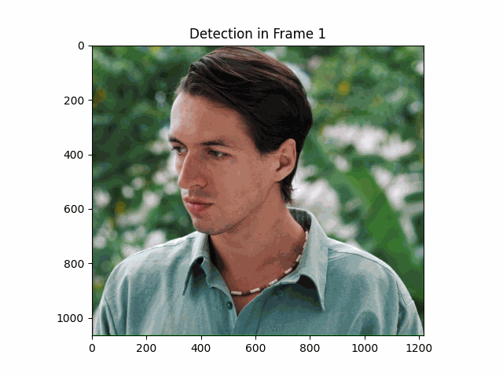
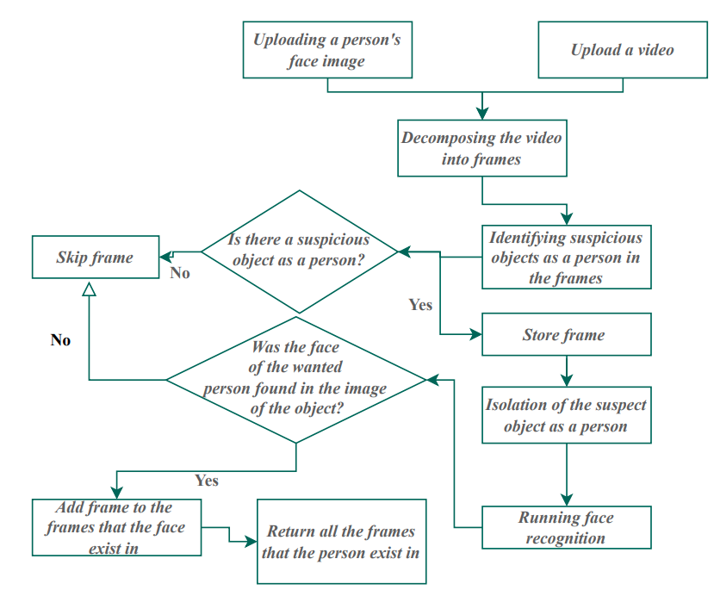

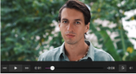
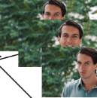
Architecture
Yolo
System
Workflow
FaceNet
Introduction
Proposed Solution
System Workflow
YOLO
FaceNet
Architecture
&
Diagrams
Expected Challenges
User Interface
Improvements
Testing
05

Slide 6
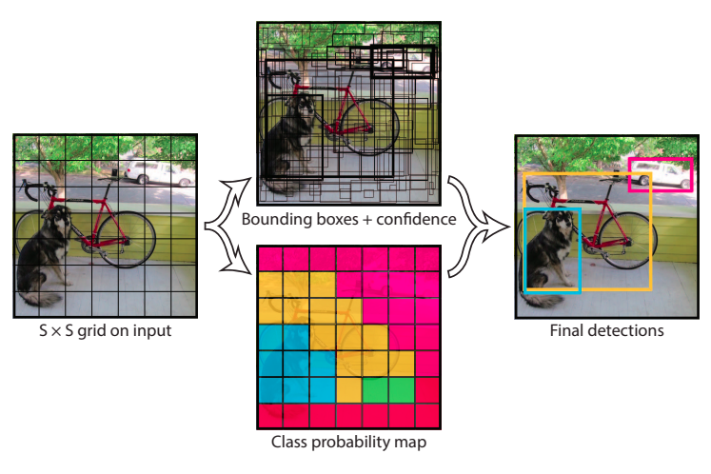

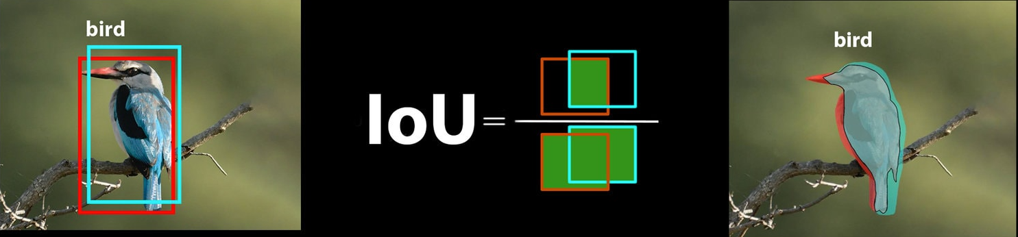
Yolo
You Only Look Once Real-time object detection system
Single convolutional neural network
Divides the input image into a grid system
Each cell in the grid is responsible for detecting objects within itself
Predicts bounding boxes and class probabilities
Non-Maximum Suppression.
Introduction
Proposed Solution
System Workflow
YOLO
FaceNet
Architecture
&
Diagrams
Expected Challenges
User Interface
Improvements
Testing
06
Notes:
Reference : Redmon, J., Divvala, S., Girshick, R., & Farhadi, A. (2016). You only look once: Unified, real-time object detection. In Proceedings of the IEEE conference on computer vision and pattern recognition (pp. 779-788).‏
Ultralytics YOLO Docs : https://docs.ultralytics.com/models/yolov8/

Slide 7
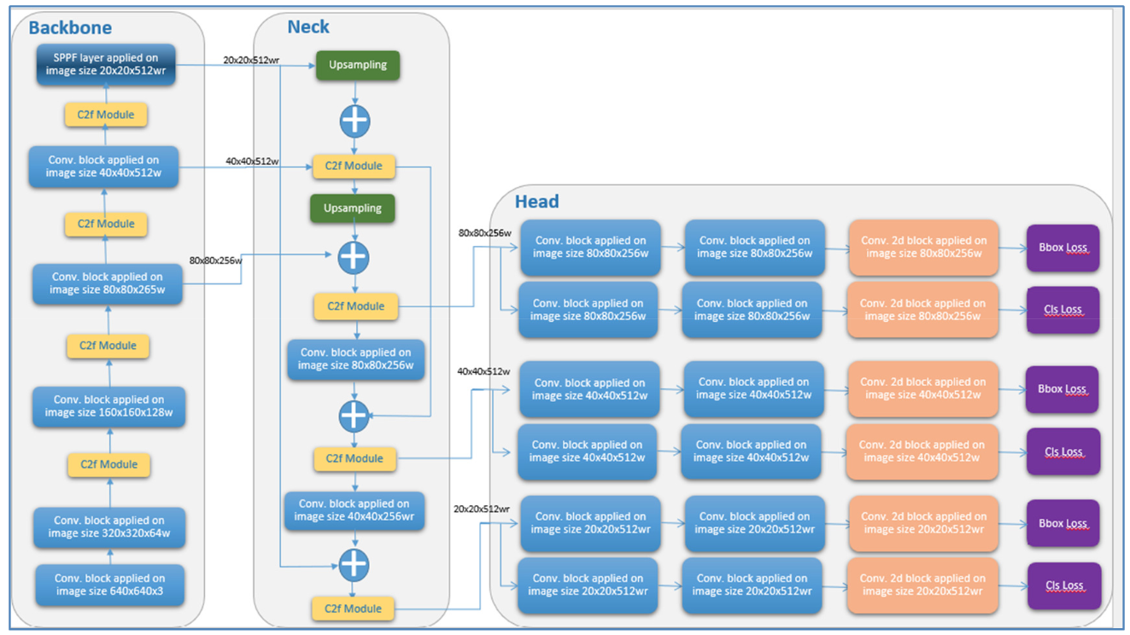
Yolo V8 Architecture
As we go Deeper
Image Size
Feature Maps
Different Scales
07
Notes:
Figure Referance :
Ahmed, R., & Abd-Elkawy, E. H. (2024). Improved Tomato Disease Detection with YOLOv5 and YOLOv8. Engineering, Technology & Applied Science Research, 14(3), 13922-13928.‏

Slide 8
Yolo V8 Architecture
Feature Pyramid Network
Combine Features From Different Levels
07
Notes:
Figure Referance :
Ahmed, R., & Abd-Elkawy, E. H. (2024). Improved Tomato Disease Detection with YOLOv5 and YOLOv8. Engineering, Technology & Applied Science Research, 14(3), 13922-13928.‏

Slide 9
Yolo V8 Architecture
07
Notes:
Figure Referance :
Ahmed, R., & Abd-Elkawy, E. H. (2024). Improved Tomato Disease Detection with YOLOv5 and YOLOv8. Engineering, Technology & Applied Science Research, 14(3), 13922-13928.‏

Slide 10
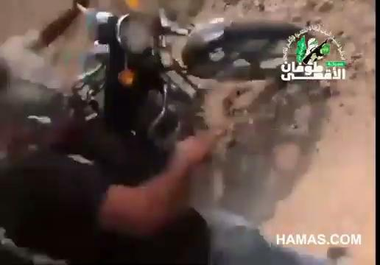
Yolo Prediction Example
08

Slide 11
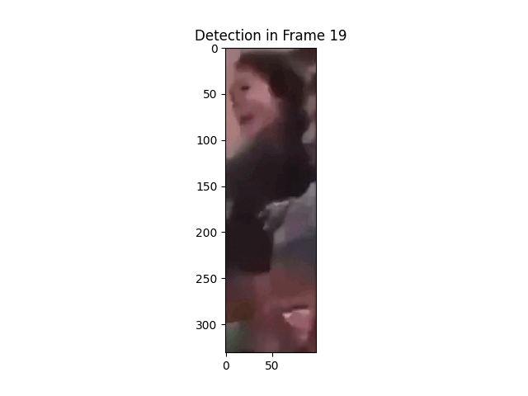
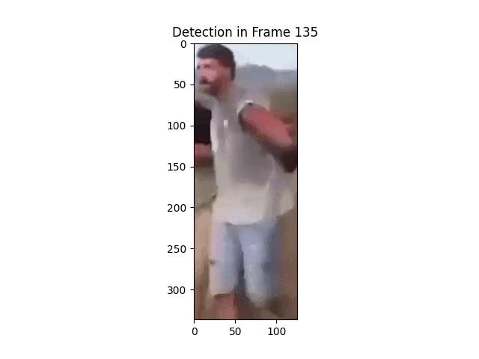

Our uses with YOLO
01
Detecting
02
Locating
03
Isolating
Introduction
Proposed Solution
System Workflow
YOLO
FaceNet
Architecture
&
Diagrams
Expected Challenges
User Interface
Improvements
Testing
09

Slide 12
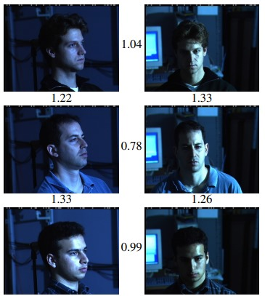
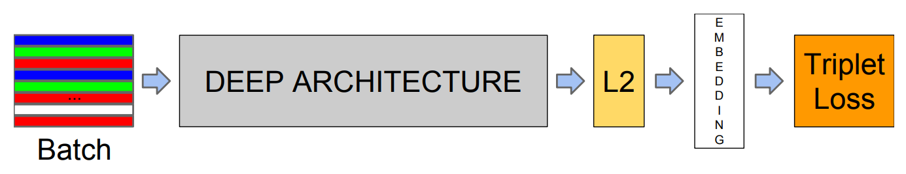
FaceNet
Facial recognition Model
Developed by Google (2015).
Transforms facial images into a Euclidean space.
Uses deep CNN for feature extraction, embedding layer for fixed-size vector representation, and triplet loss for optimized face similarity.
Effective against variations in pose, lighting, and expression.
Introduction
Proposed Solution
System Workflow
YOLO
FaceNet
Architecture
&
Diagrams
Expected Challenges
User Interface
Improvements
Testing
10
Notes:
Schroff, F., Kalenichenko, D., & Philbin, J. (2015). Facenet: A unified embedding for face recognition and clustering. In Proceedings of the IEEE conference on computer vision and pattern recognition (pp. 815-823).‏‏

Slide 13
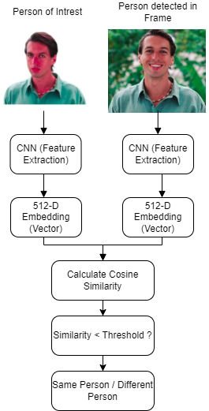
Person of
Interest
Person Detected
in frame
Our uses with FaceNet
Identifying the presence of specific individuals within video frames.
Comparing detected faces to the provided image for verification.
Marking and returning frames containing the identified individual.
Introduction
Proposed Solution
System Workflow
YOLO
FaceNet
Architecture
&
Diagrams
Expected Challenges
User Interface
Improvements
Testing
11
Notes:
Schroff, F., Kalenichenko, D., & Philbin, J. (2015). Facenet: A unified embedding for face recognition and clustering. In Proceedings of the IEEE conference on computer vision and pattern recognition (pp. 815-823).‏‏

Slide 14
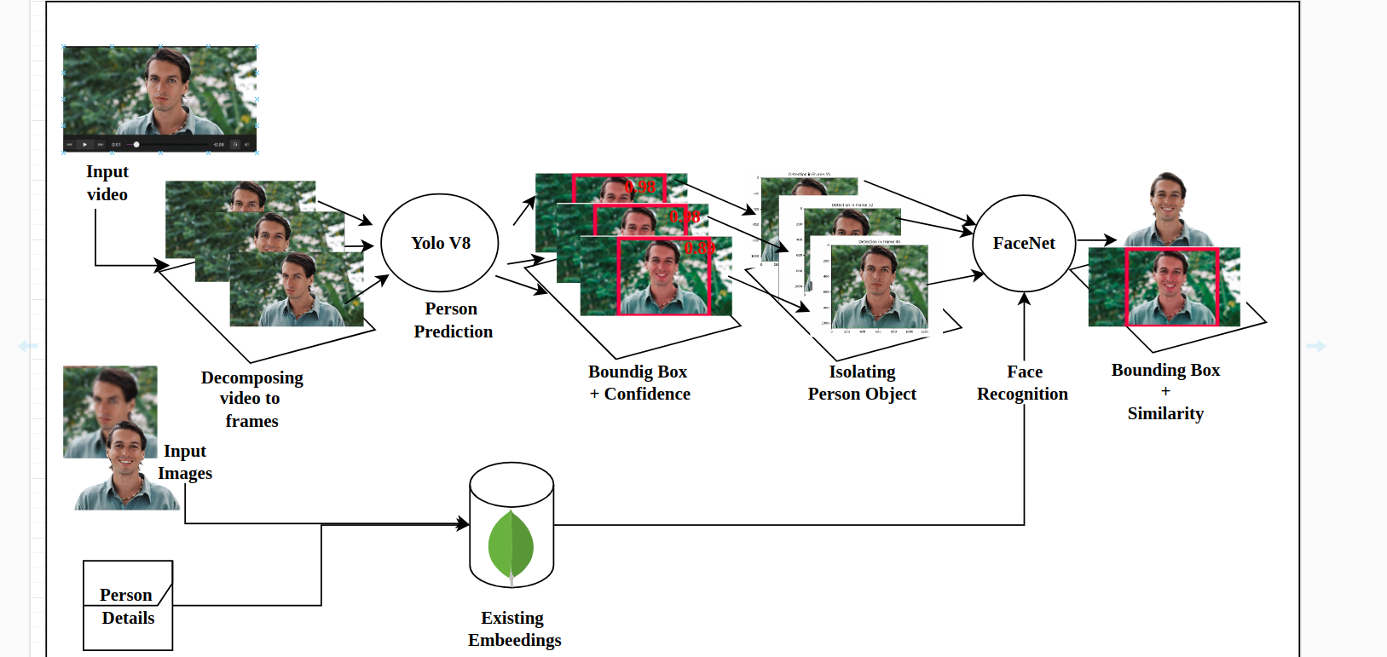
Architecture
Yolo
FaceNet
Result
Result
Algorithm
Algorithm
Introduction
Proposed Solution
System Workflow
YOLO
FaceNet
Architecture
&
Diagrams
Expected Challenges
User Interface
Improvements
Testing
12
Notes:
כמו שאתם זוכרים , דיברנו ארכיטקטורה ועכשיו נכנס עמוק יותר

Slide 15
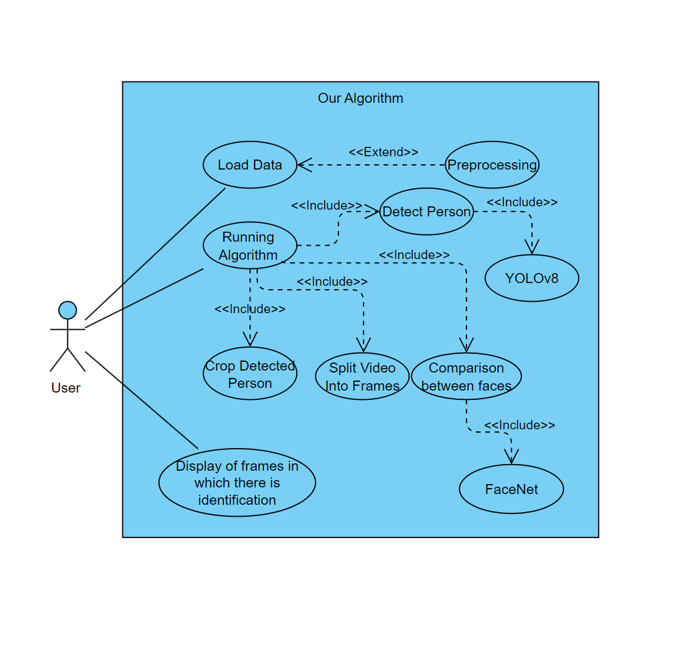
Use Case
Diagram
Introduction
Proposed Solution
System Workflow
YOLO
FaceNet
Architecture
&
Diagrams
Expected Challenges
User Interface
Improvements
Testing
13

Slide 16
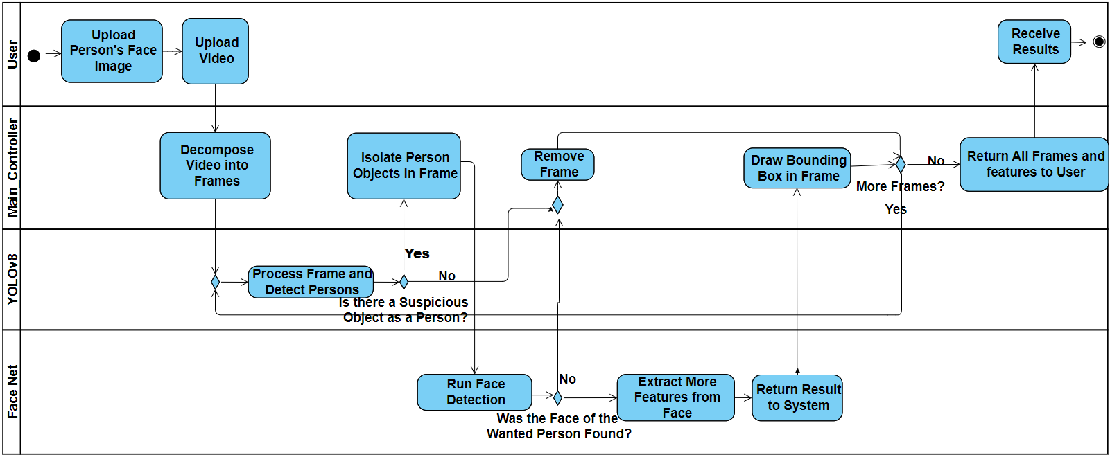
Activity Diagram
Introduction
Proposed Solution
System Workflow
YOLO
FaceNet
Architecture
&
Diagrams
Expected Challenges
User Interface
Improvements
Testing
14

Slide 17
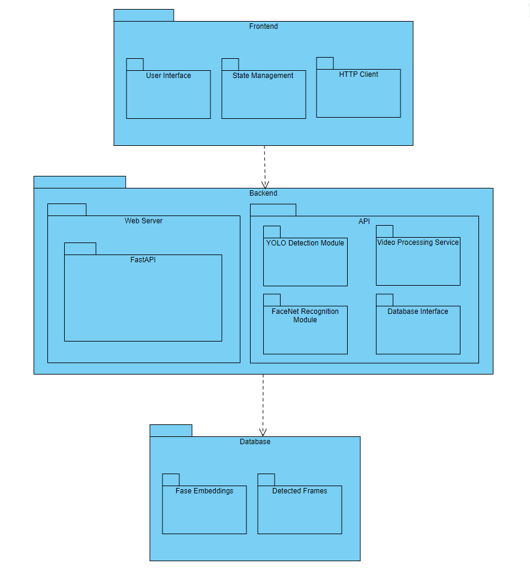
Package
Diagram
Introduction
Proposed Solution
System Workflow
YOLO
FaceNet
Architecture
&
Diagrams
Expected Challenges
User Interface
Improvements
Testing
15

Slide 18

Introduction
Proposed Solution
System Workflow
YOLO
FaceNet
Architecture
&
Diagrams
Expected Challenges
User
Interface
Improvements
Testing
16

Slide 19
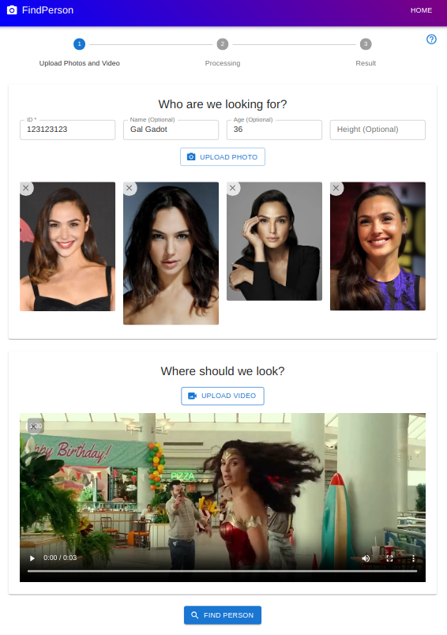
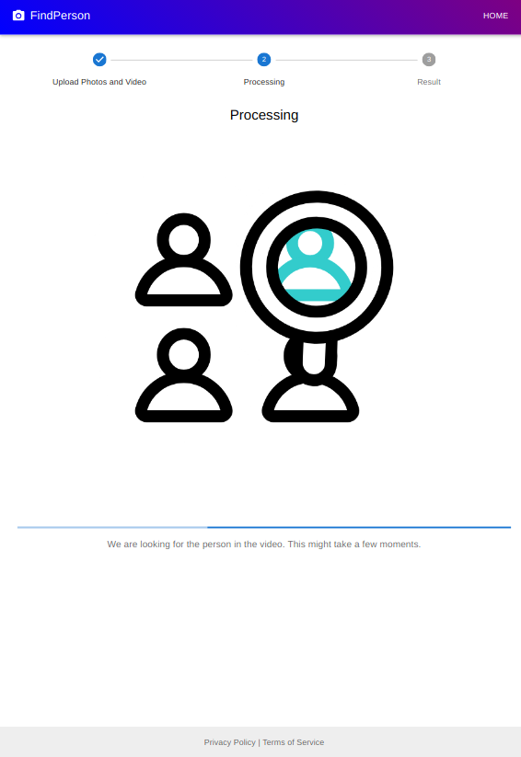



User
Interface
16

Slide 20
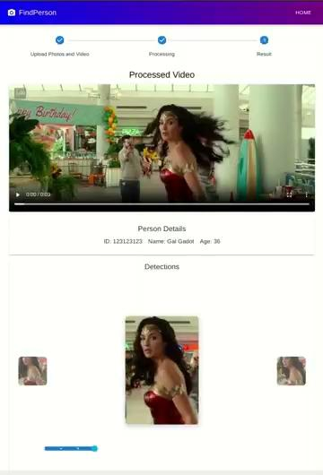
User
Interface
16

Slide 21
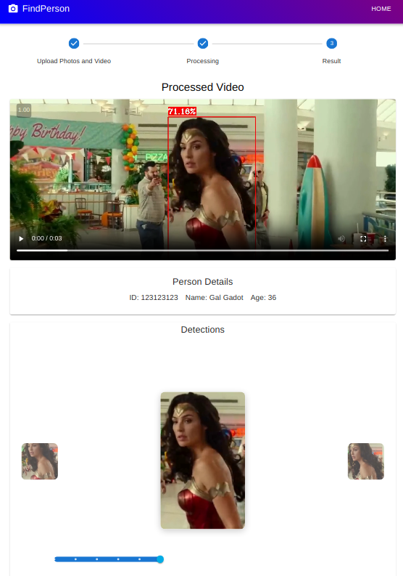
User
Interface
16

Slide 22
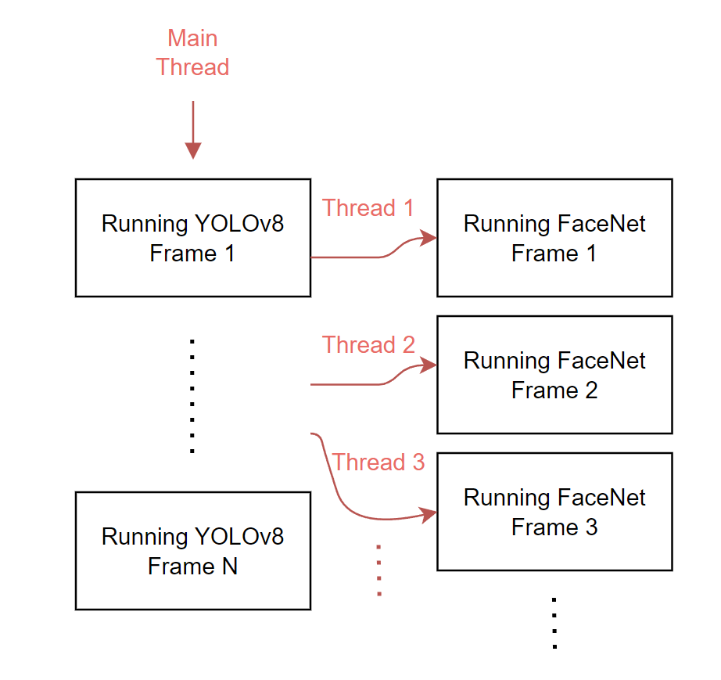
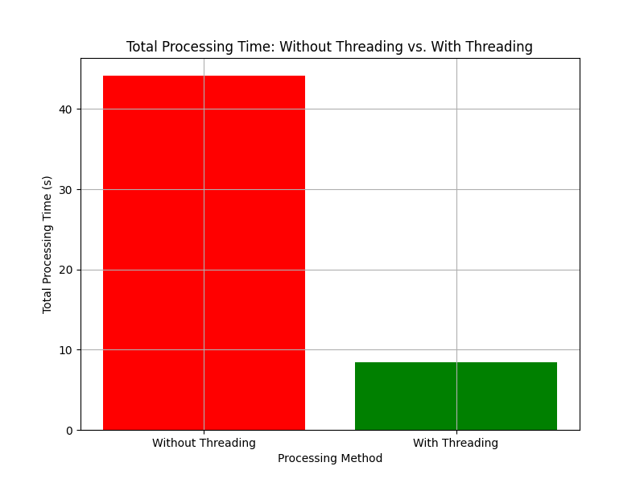
Performance Enhancements
Multi-Threading
FaceNet's face recognition process was identified as a performance bottleneck.
Initiate multiple worker threads, the same number of available CPU cores.
Each frame that YOLO processes handed off to an available FaceNet worker thread.
Introduction
Proposed Solution
System Workflow
YOLO
FaceNet
Architecture
&
Diagrams
Expected Challenges
User Interface
Improvements
Testing
17
Notes:
Schroff, F., Kalenichenko, D., & Philbin, J. (2015). Facenet: A unified embedding for face recognition and clustering. In Proceedings of the IEEE conference on computer vision and pattern recognition (pp. 815-823).‏‏

Slide 23
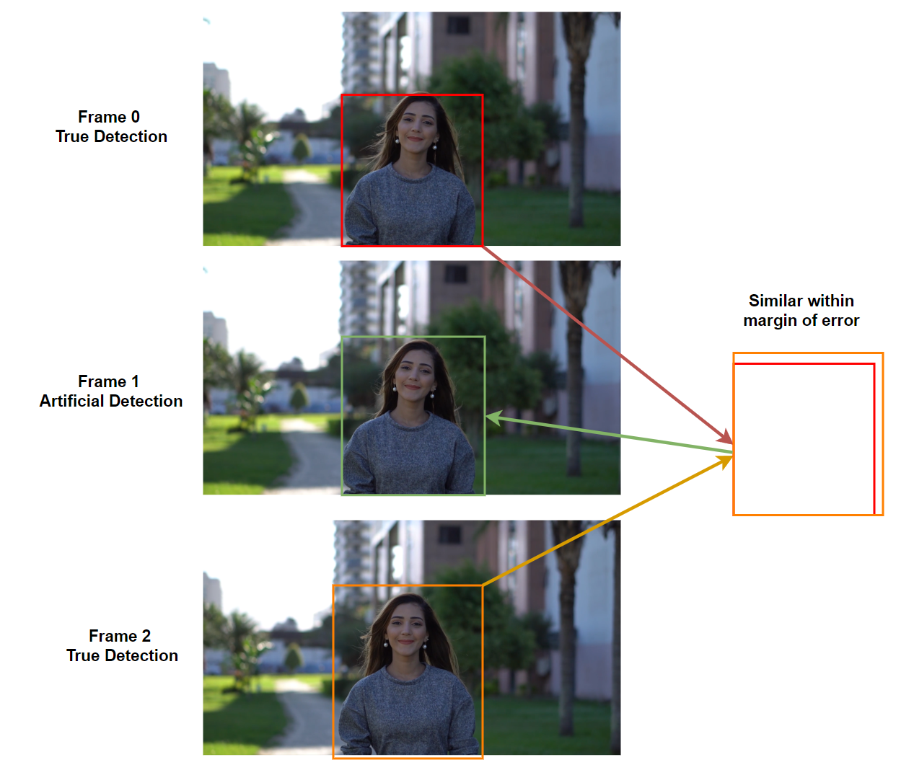
Performance Enhancements
Frame Skipping
YOLO and FaceNet are only run on even numbered frames.
Check the odd frame between two detected even frames.
Add artificial annotation to the odd frame, simulating detection.
Introduction
Proposed Solution
System Workflow
YOLO
FaceNet
Architecture
&
Diagrams
Expected Challenges
User Interface
Improvements
Testing
18
Notes:
Schroff, F., Kalenichenko, D., & Philbin, J. (2015). Facenet: A unified embedding for face recognition and clustering. In Proceedings of the IEEE conference on computer vision and pattern recognition (pp. 815-823).‏‏ להוריד את הכמות טקסט

Slide 24
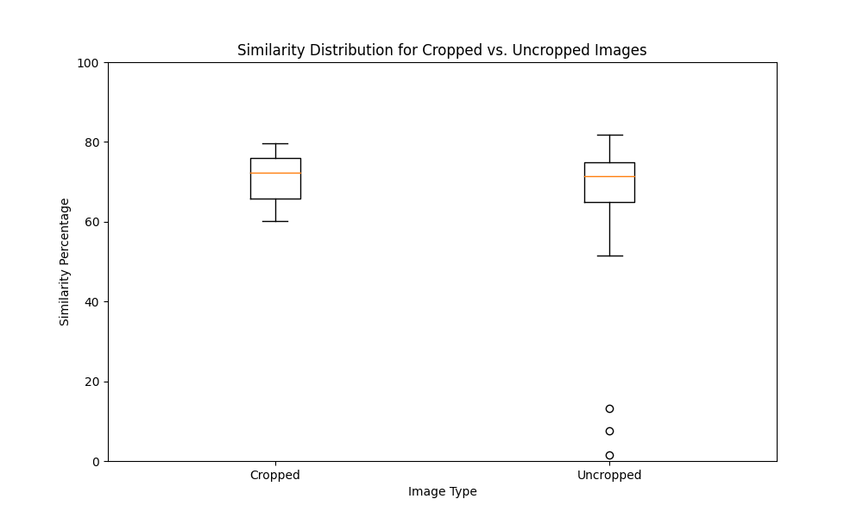
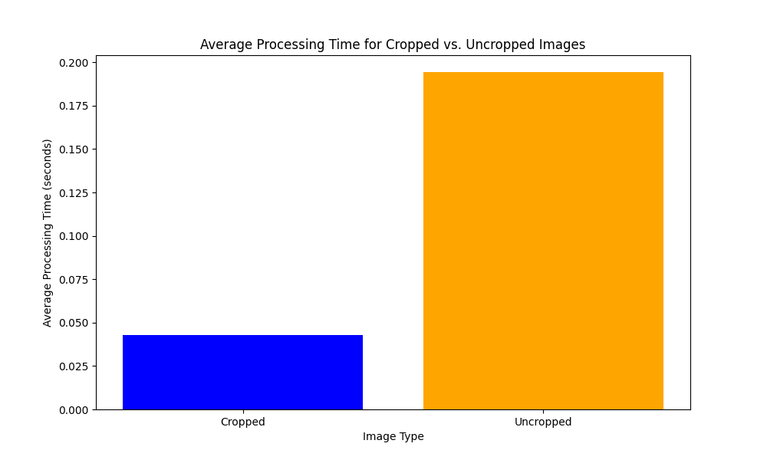
Region of Interest
02
Higher average similarity scores
01
Cropping images significantly reduces processing time
02
03
Performance Enhancements
02
5.41x Faster
Introduction
Proposed Solution
System Workflow
YOLO
FaceNet
Architecture
&
Diagrams
Expected Challenges
User Interface
Improvements
Testing
15
19
Notes:
במקומו לשים תוצאות עם גרפים תוצאות מקרים השוואות

Slide 25
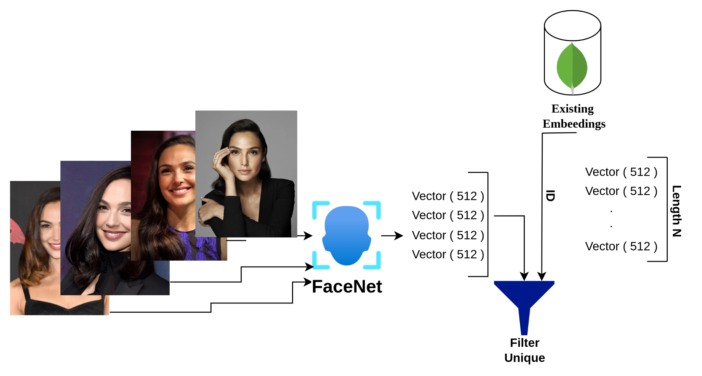
02
Learning and Data Refinement
Faces that were detected earlier and have a similarity greater than 80% with
samd id
Comprehensive set of embeddings .
01
01
03
User Details .
02
01
Performance Enhancements
02
Query
03
Information filtering .
03
Introduction
Proposed Solution
System Workflow
YOLO
FaceNet
Architecture
&
Diagrams
Expected Challenges
User Interface
Improvements
Testing
15
20
Notes:
במקומו לשים תוצאות עם גרפים תוצאות מקרים השוואות

Slide 26
Testing
Test Description | Expected results | Result
Test YOLO accuracy of person detection | High accuracy and recall measure in person detection | Passed
Test FaceNet accuracy of facial recognition | High accuracy and recall in measure in facial recognition | Passed
Validate full process from video and person upload to results | System returns all frames where the person exists in the video | Passed
Introduction
Proposed Solution
System Workflow
YOLO
FaceNet
Architecture
&
Diagrams
Expected Challenges
User Interface
Improvements
Testing
21
Notes:
תוצאות הטסטים כל טסט שהצגנו פה נחליף בטסט אמיתי עם תוצאה לבחור 3 גג

Slide 27
THANK YOU!
22

